Slide 1














Credit Card Fraud Detection using Machine learning
Presented by:
Keerthana Aluri
Sai Sarvagna Beeram
1

Slide 2

Motivation
Why Fraud Detection is Critical:
Fraudulent transactions are a major issue in financial systems, leading to billions in losses annually.
Machine learning models can identify patterns in large datasets, providing a more scalable and accurate solution.
Key Motivational Points:
Security Enhancement
User-Centric Design
2
Notes:
Motivation of the project:
Why is Fraud Detection Critical, Fraudulent transactions pose a significant threat to financial systems, resulting in billions of dollars in losses each year. With the rise of digital payments and e-commerce, the need for an intelligent, proactive fraud detection system has never been more critical.
By leveraging advanced ML models, our system offers quick and accurate predictions, enabling timely interventions.
Security Enhancement: Protecting users and businesses from financial fraud is paramount.
User-Centric Design: The integration of a web-based interface ensures accessibility, making fraud detection intuitive and interactive for users.
This project aims to bridge the gap between user-friendly interfaces and robust machine learning algorithms to combat financial fraud efficiently.

Slide 3
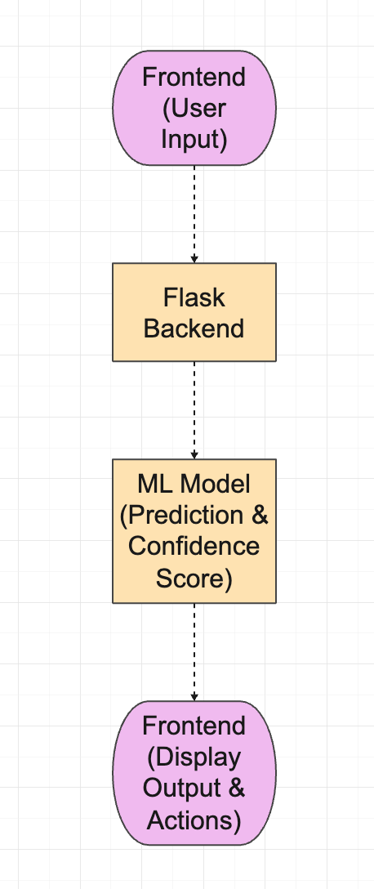

Problem Definition
Fraudulent transactions are mixed with legitimate transactions in large datasets, making it challenging to identify fraud without automation.
Objective:
Build a machine learning model through a web interface that can classify transactions as fraudulent or non-fraudulent based on transaction characteristics and user behavior.
3
Notes:
This is our models problem statement we are implementing a Fraud Detection System where the user inputs transaction details through a web interface built using Flask. The details from the form are analyzed by the machine learning model to predict the likelihood of the transaction being fraudulent.

Slide 4


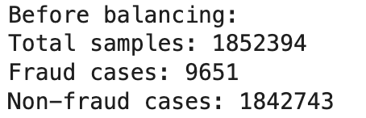


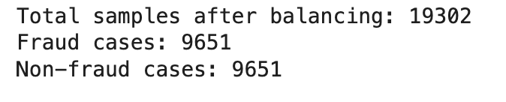
Methodology Proposed
Data Collection:
Source: Kaggle
Contains transaction data for 1,000 customers across 800 merchants, including both fraudulent and non-fraudulent transactions.
2.Data Preprocessing:
Load the data and performed Exploratory Data analysis.
Before Balancing (Initial Data): (Through EDA)
Imbalance issue ?
After Balancing (Resampling):
Resampling
(Undersampling)
4
Notes:
Now, i will walk through,how we developed our model
Starting with Data Collection -
we're using Kaggle data that contains transaction records for 1,000 customers across 800 merchants, with both fraudulent and non-fraudulent cases.
next we perfermoed datapreprocessing,
Imbalance Issue?
Fraud cases are rare (~0.5%), making it challenging for models to detect fraud accurately.
Why Balancing?:
Balancing the dataset helps the machine learning model learn to detect fraud more effectively since the model won't be biased towards predicting only the majority class (non-fraud).

Slide 5
Methodology Proposed
Through EDA we found that, there are no missing values and duplicates in the dataset.
Removing Unnecessary Columns:
Removed columns that were redundant, too specific, or irrelevant to the task, such as
personal identifiers(first, last, dob)
geographic labels (city and state replaced by coordinates like lat, long, merch_lat, merch_long)
redundant timestamps(unix_time)
Temporal Feature Extraction:
Converted the transaction timestamp into multiple features, such as:
Transaction day, month, year
Hour and minute of the transaction
Weekday (e.g., Monday, Tuesday)
Weekend flag (indicating whether the transaction occurred on a weekend)
Geographic Feature Engineering:
Calculated the distance between the cardholder's location and the merchant's location using latitude and longitude.
5
Notes:
Removed columns that were redundant, too specific, or irrelevant to the task, such as pearsonal identifiers, geographic labels (replaced by coordinates), and redundant timestamps.
Results:
by doing this,
The dataset was reduced to meaningful features, improving model interpretability and reducing noise
Temporal Feature Extraction
so here, we are creating
New temporal features were created to capture patterns in fraudulent behavior, such as unusual activity during specific times or days.
c. Geographic Feature Engineering
Results:
A "distance" feature was added to represent the proximity of transactions, as fraudulent transactions often occur at unexpected or faraway locations.
The model predicts fraud based on several key aspects:
Location Analysis:
Checks distances between merchant and cardholder
Analyzes geographic patterns
Flags unusual location sequences
Time-Based Rules:
Examines transaction timing
Looks for suspicious patterns in day/hour
Analyzes frequency of transactions
Amount Patterns:
Evaluates transaction amounts against normal patterns
Looks for suspicious sequences (like small test amounts followed by large charges)
Considers category-specific amount norms
Combined Features:
Assesses multiple factors together
Weighs different risk indicators
Creates composite risk scores
The XGBoost model specifically:
Creates decision trees based on these features
Assigns importance weights to different patterns
Makes predictions based on combined risk factors

Slide 6

Methodology Proposed
Label encoding
Encoding Categorical Variables:
Transformed categorical variables (e.g., transaction category, credit card number) into numerical representations using encoding techniques.
Scaling Numerical Features:
Applied scaling to numerical features like transaction amount, city population, and distance to standardize their ranges.
Train-Test Split:
The dataset was split into:
Training set: 80% of the data
Testing set: 20% of the data
Stratified sampling ensured that the fraud-to-non-fraud ratio was preserved in both subsets.
3) Model Used (XGBoost):
A powerful, advanced model based on gradient boosting that combines multiple weak models (trees) to create a strong model.
6
Notes:
d. Encoding Categorical Variables
Results:
Categories were encoded into numerical values suitable for machine learning algorithms.
The dataset was prepared for compatibility with models that cannot directly process categorical data.
Numerical Scaling (Standardization):
While not a traditional "encoding" method, standardization was applied to certain numerical features to bring them to a common scale.
What It Does:
Numerical scaling transforms numeric data to have a mean of 0 and a standard deviation of 1, which helps improve the performance of models sensitive to feature magnitude, such as gradient-based algorithms.
Train-Test Split
Objective:
To split the preprocessed dataset into training and testing subsets for model evaluation.
Results:
The dataset was split into:
Training set: 80% of the data
Testing set: 20% of the data
Stratified sampling ensured that the fraud-to-non-fraud ratio was preserved in both subsets.

Slide 7

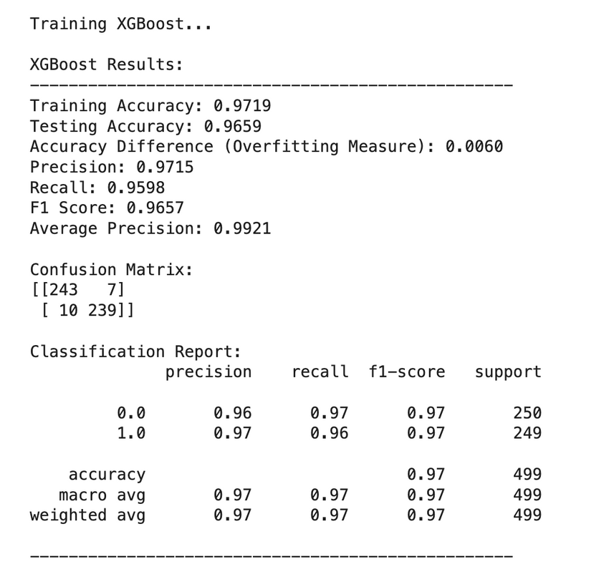
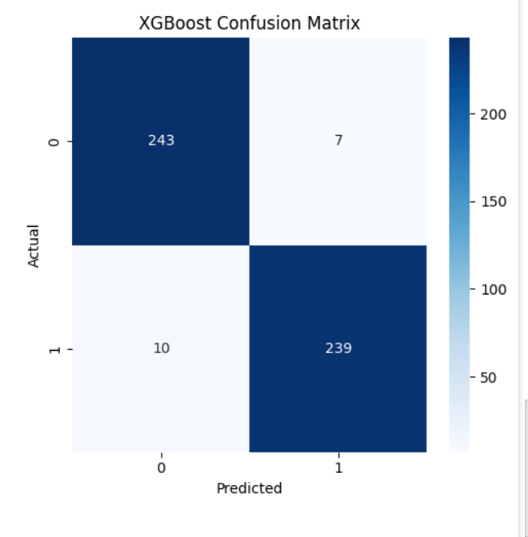
Experimental Results(Model Performance)
7

Slide 8
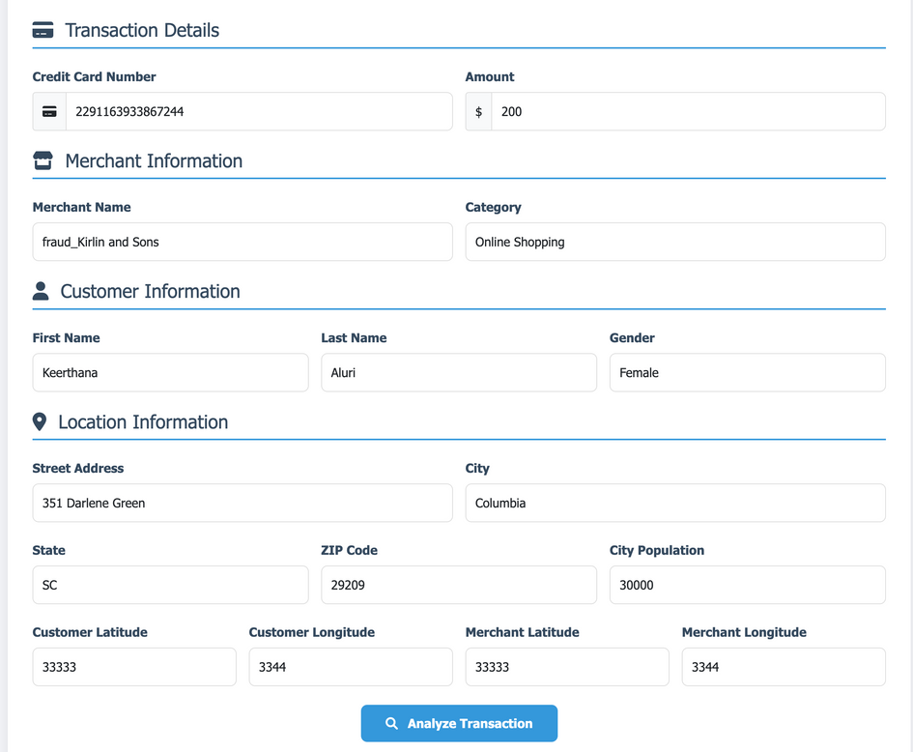
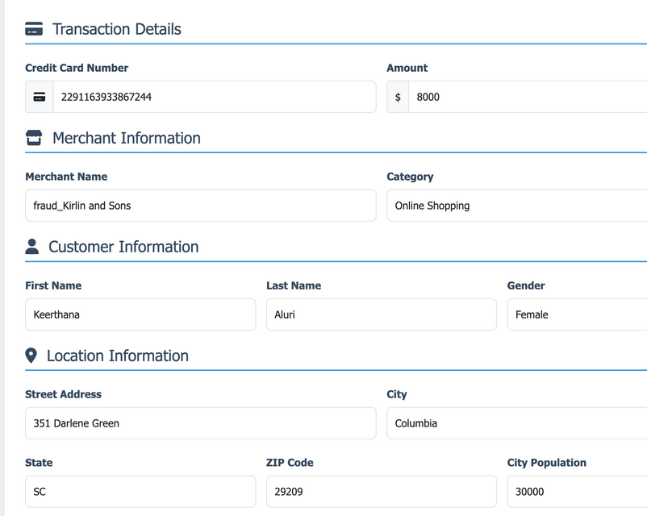
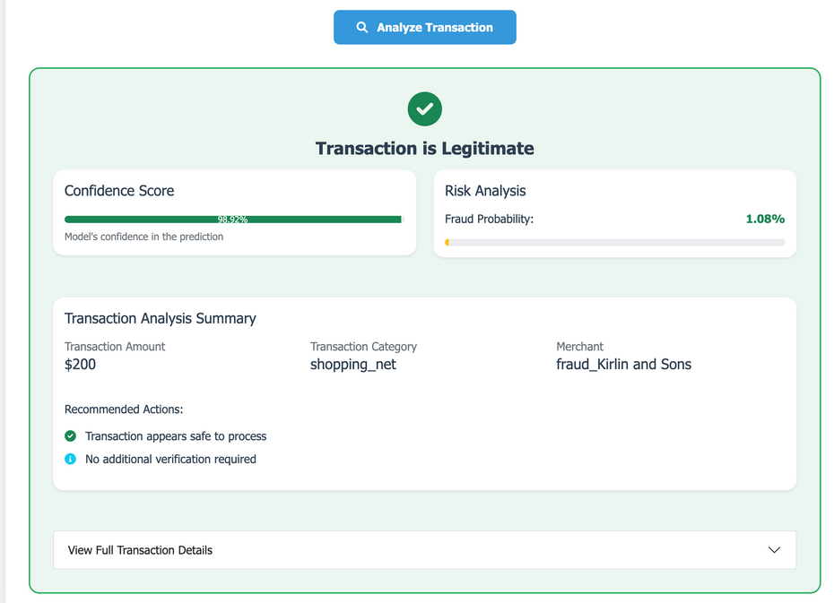
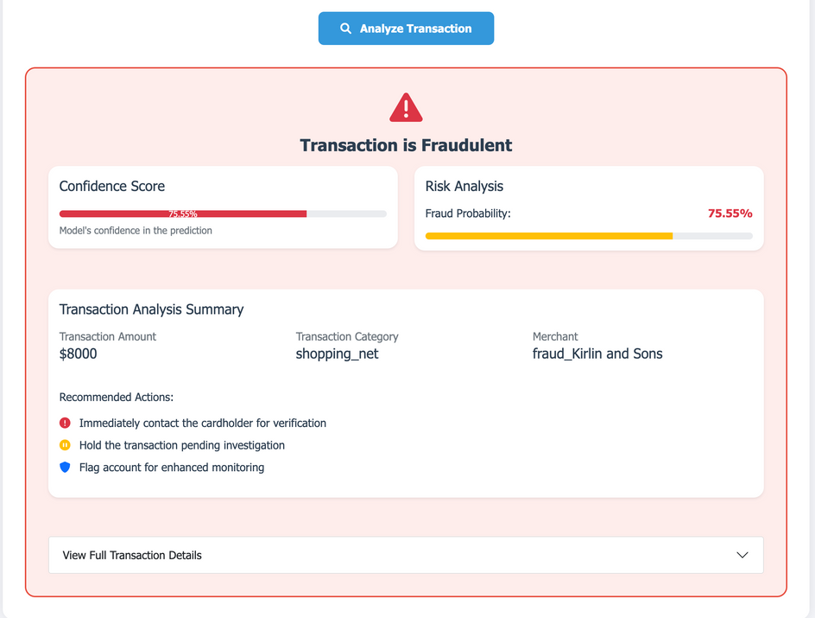
Experimental Results (UI)
7

Slide 9
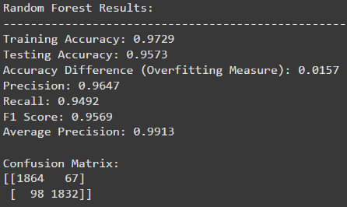
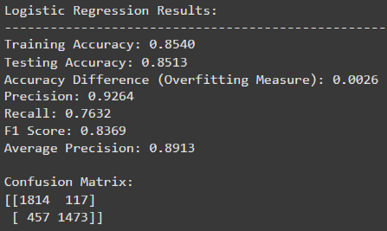
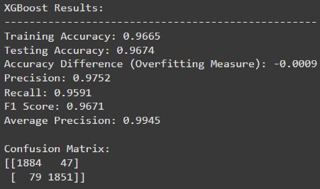
Comparision of Different Methods
8
Notes:
Coming to Performance Comparison:
Random Forest: High performance with a testing accuracy of 95.73%.
Displays minimal overfitting (training-testing accuracy difference of ~1.57%).
Logistic Regression: Lower testing accuracy at 85.13% but demonstrates stability with minimal overfitting.
Precision and recall indicate reasonable detection of fraud cases but are less effective than Random Forest.
The XGBoost results showcase an impressive performance for the model.
The minimal accuracy difference btw training and testing accuracy(-0.0009) indicates no significant overfitting, reflecting a well-generalized model.
The model performs equally well across both classes (0 and 1), with macro and weighted averages aligning with the overall accuracy.

Slide 10
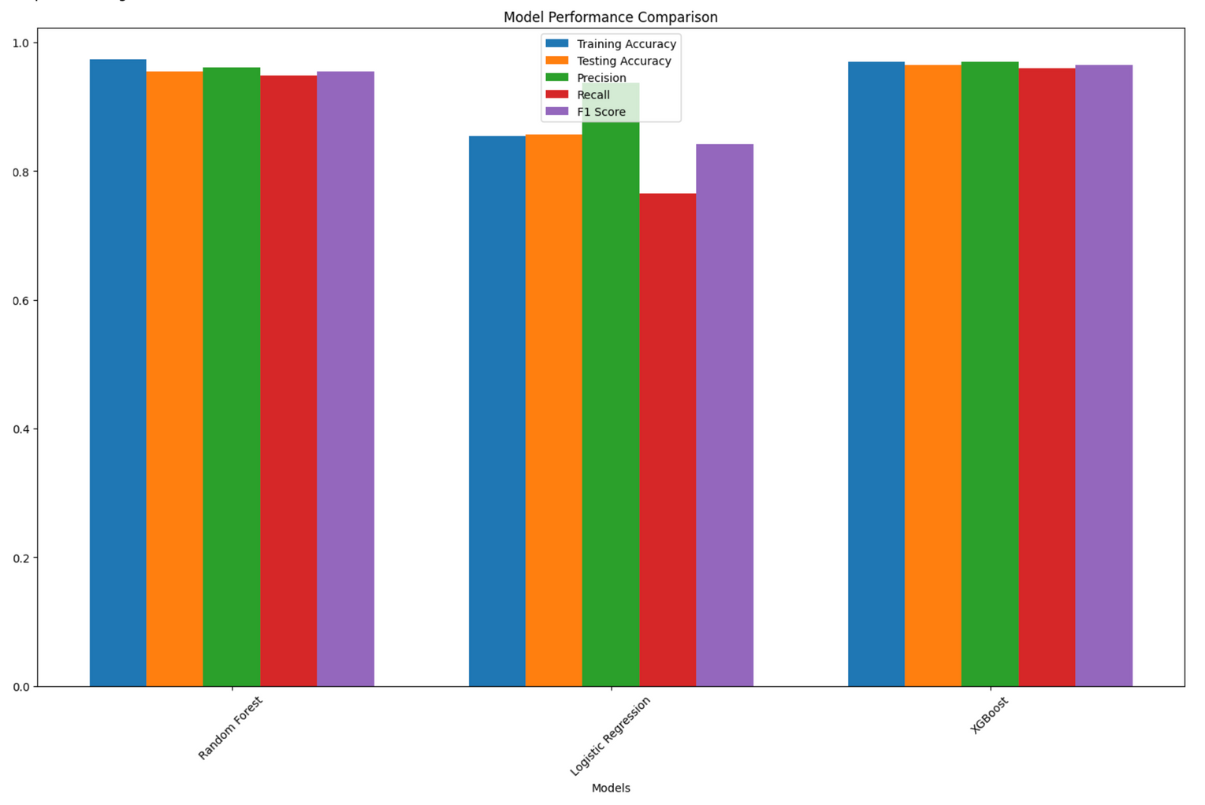
Bar Chart Display:
9
Notes:
This is the bar chart displaying the performance metrics of machine learning models. Each group of bars represents a set of metrics Training Accuracy, Testing Accuracy, Precision, Recall, and F1 Score.

Slide 11

Conclusion & Future Steps
Project successfully identified fraudulent transactions with high accuracy, demonstrating the potential of machine learning in combating financial fraud.
XGBoost offers the best performance among the algorithms tested.
Explore advanced techniques like deep learning for fraud detection.
Implement real-time fraud detection in production systems.
Improve the model by incorporating more diverse features (e.g., social network data, transaction history).
10

Slide 12
Thank you very much!
Any Questions ?
11

